Slide 1
DISASTER AND THEIR MANAGEMENT
In natural catastrophes such as floods, cyclones, earthquakes, droughts, Tsunami, volcanic eruptions happen from time to time causing damage to the life and property.
Some disasters are caused by human activities such as fires industrial accidents, forest fires, epidemics are equally devastating.
Biological disasters like dengue, HIV covid,influenza can also happen.
Hazards
A natural hazard is a threat of naturally occurring event will have a negative effect on humans.

Slide 2
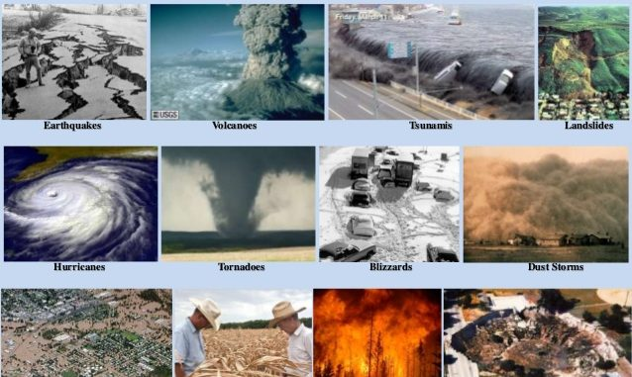

Slide 3
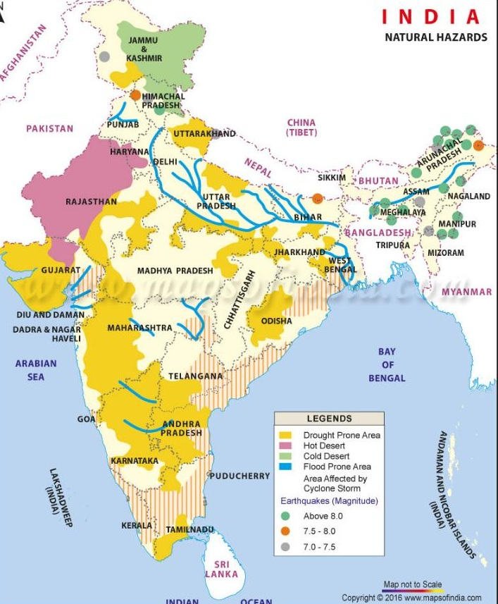

Slide 4
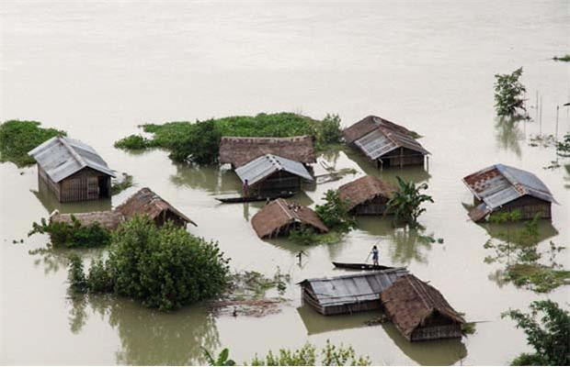
When hazards actually happen and harm life and prpperty we call it disaster.
DISASTERS IN INDIA
Floods, droughts, earthquakes, cyclones and sometimes tsunamis also happen in India.
FLOODS

Slide 5
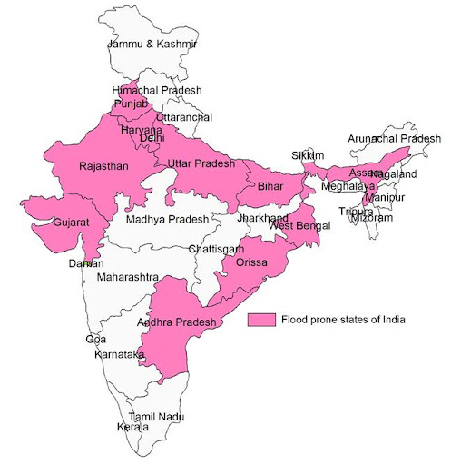

Slide 6
Flood is the overflowing rivers and water reservoirs.
CAUSES OF FLOODS
Heavy rains, cyclones, cloud busts, tsunamis , siltation of rivers and reservoirs.
EFFECTS
Loss of human beings and livestock
Shortage of safe drinking water
Loss of property and crops
Damage caused to rails, roads, dam, crops, uprooting of trees
Landslide and soil erosion.
Loss of vehicles, machinery
Utilities such as water supply, sewerage, communication lines, transport , network are disrupted.
Spread of diseases after flood is over.

Slide 7
MANAGEMANT
Afforestation should be done ,construction of dams’, identification of flood prone area.
Flood forecasting – Alerting people to move to safe places from areas of submergence
Flood warnings- In India central water commission, irrigation and flood control department
Land use planning- Construction of roads, railways, houses on elevated area
What people should do?
Remain alert upon flood forecasting information.
Move food, water and valuables to elevated places.
Store extra food and water in case of emergency.
Don’t touch any electric wire.
Take special care of small children and old persons and physically challenged .

Slide 8
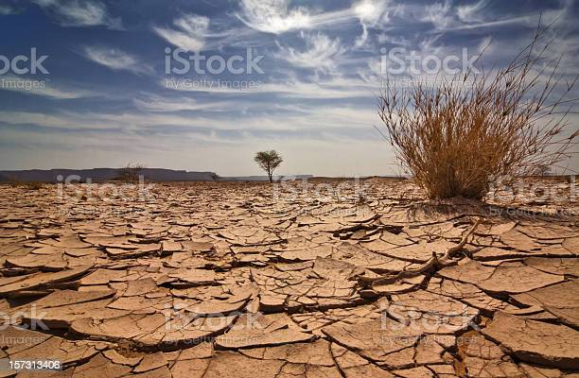
Droughts
When rainfall is less than expected normal rainfall. The low rainfall is insufficient to meet the needs of humans, animals, plants and agriculture is drying of rivers, lake, ponds, wells, poor recharge of underground water.

Slide 9
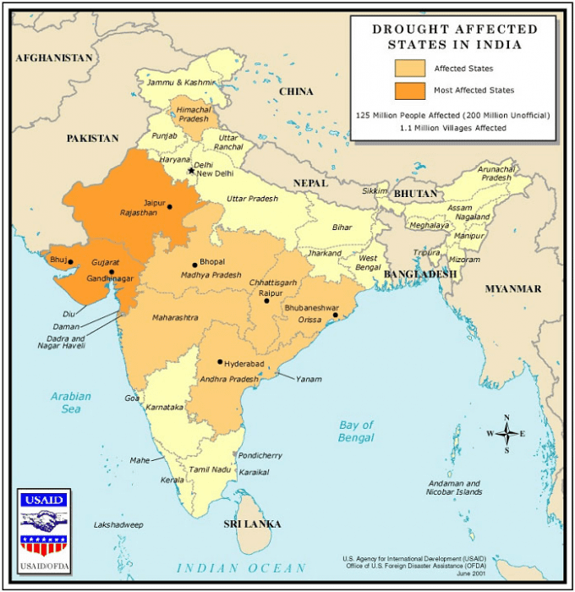

Slide 10
Effects
Severe loss of agriculture.
Affects dairy activities fisheries.
Depletion of underground water.
Loss of bio-diversity.
Social unrest.
Health problems and increased poverty.
Management
A regular monitoring of rainfall water availability in reservoirs, lake, rivers.
To adopt water conservation measures to reduce water consumption.
To adopt efficient methods of irrigation like drip irrigation,sprinkle irrigation.
To reuse waste water.
Growing drought resistant crops.
Rain and roof water harvesting.
To construct small check dams.

Slide 11
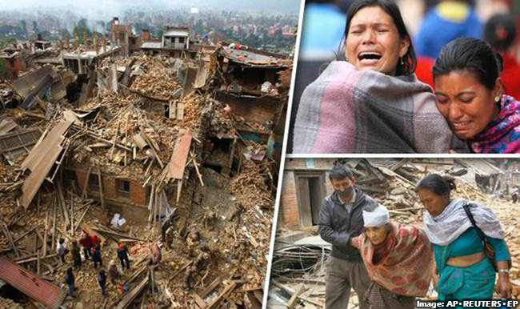
Earthquake

Slide 12
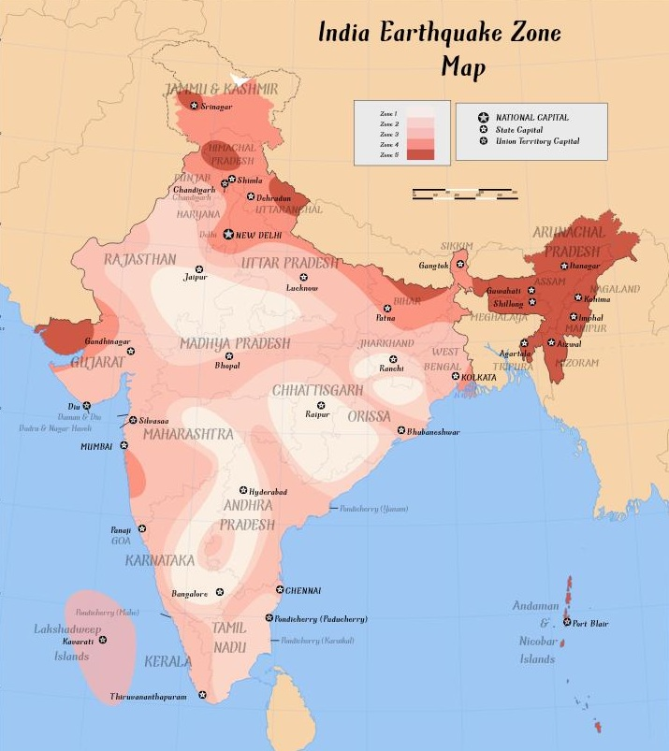

Slide 13
Earthquake is sudden release of energy accumulated in deformed rocks of earth’s crust causing the ground to shake. Earth experience 8000-10000 earthquakes annually.
Causes
Volcanic eruptions
Movement of tectonic plates
Isostatic adjustment
Construction of dams and blasts
Folding and faulting

Slide 14
Management
move out in open
Keep clam and keep away from windows, mirrors.
Buildings should be constructed accoding to NBC of india
Stand under strong beams
Creep under dining table or strong bed.
Cover your body with pillows, blankets or quilt to protect yourself from falling objects.
If travelling stop the vehicle away from buildings.
Stand away from tall building, electricity poles.
Buildings should be designed such a manner, they can withstand the stress of earthquakes.

Slide 15
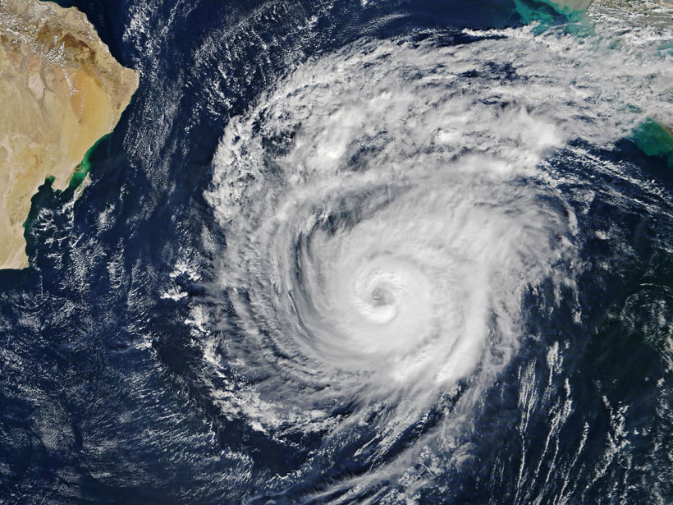
Cyclones
Cyclones are violent storms characterized by strong and high speed winds rotating about a calm center of low atmospheric pressure with wind velocity 50-250 km/hour cyclones are followed by heavy rains causing floods and destruction.

Slide 16
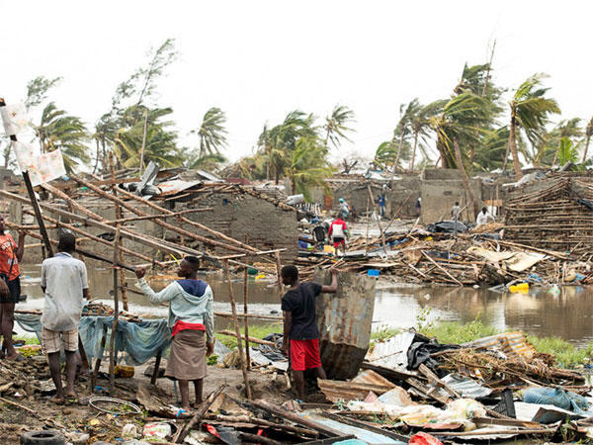

Slide 17
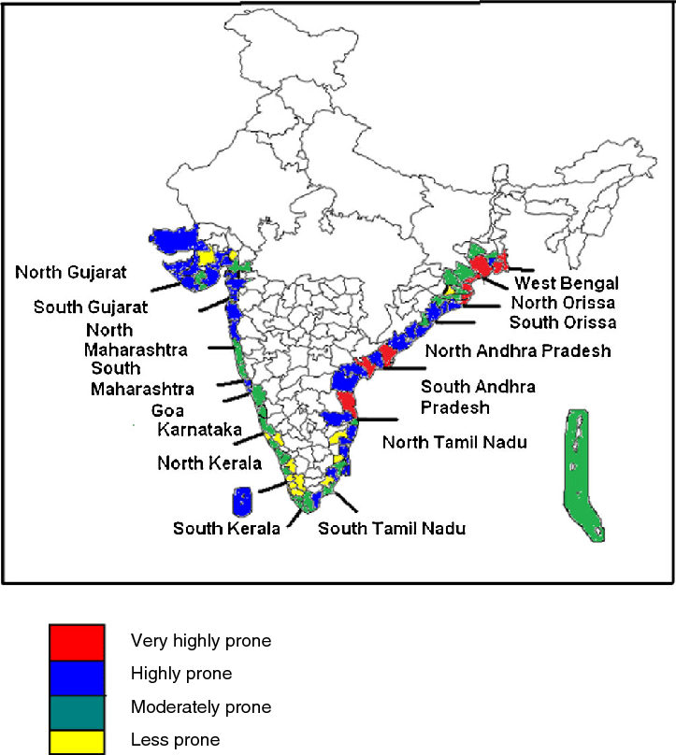

Slide 18
Effects
Light weight structure, old buildings, weak structures are at risk.
Settlements are vulnerable to floods, mudslides, landslides due to heavy rain.
Telephone and electricity poles, wires, light buildings structures such as thatched, tin, shed roof , sign boards, fishing boats, trees are most vulnerable to cyclone damages.
Due to heavy rains people, animals and their property may be washed away by floods or blown away by cyclone itself.
Cyclones along the coastal areas may cause sea water to enter inland and floods it. This may cause saline water contamination of soil & water in the affected area affecting severely water supply and affecting agriculture crops.
Management
Identify Cyclone prone areas
Green belts should be developed along the coastal areas.

Slide 19
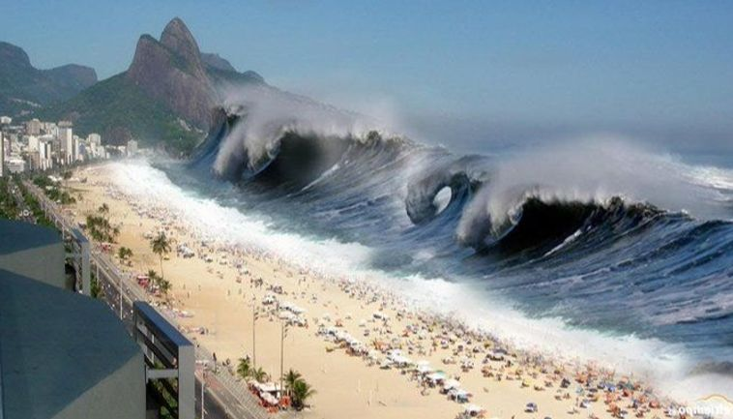
Tsunami
It is called seismic sea wave, catastrophic ocean wave caused by earthquake occurring with a magnitude greater than 6.5 on Richter scale. Under sea landslides/ volcanic eruptions may also cause tsunami.

Slide 20
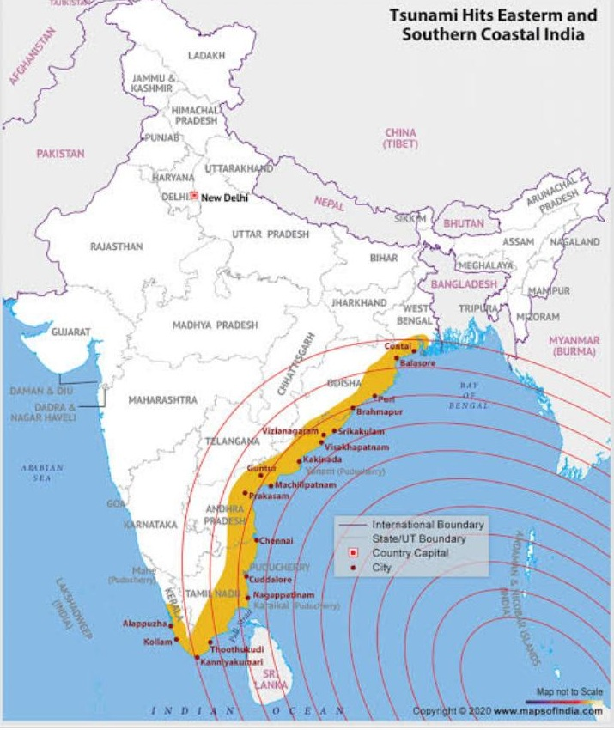

Slide 21
Tsunami a train of simple progressive oscillatory waves in propagated to great distances in ever widening circle as the wave up to height 50 m land above are seen.
Effects
Hugh water of sea enters causing floods washing away every thing
The famous tsunami of 2004 had devastating effects on coastal areas of India, Malaysia, Indonesia,Srilanka killing more than 2lac people in Asian countries other effects are same as caused by cyclones/ floods mitigation are same to those of floods.
Management
Alert by warning system and movement of animals

Slide 22
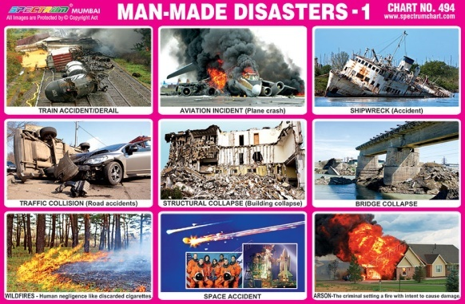
Man-made / anthropogenic disasters

Slide 23
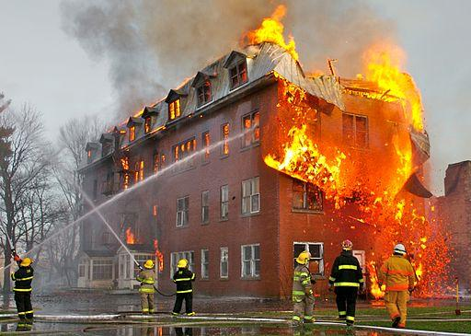
Fires
Fires in forests, homes, factories, godowns, jungles, may lead to death of many people due to burns and asphyxiation.

Slide 24
Causes
Throwing of burning match sticks on any fire catching material.
Cooking accidents gas leakage.
Short electric circuit
Waste material burnt outside roadside may catch fire.
Storage and transportation of explosive material chemical without proper precaution.
Effects
Deaths-human / livestock-injuries.
Loss of human life, plants life, buildings are destroyed, forests are destroyed.
Loss of flora and fauna.

Slide 25
Remedies—Precautions →
Don’t leave any burning material in forests or anywhere.
Be careful while cooking.
Electric wires should be checked after intervals

Slide 26
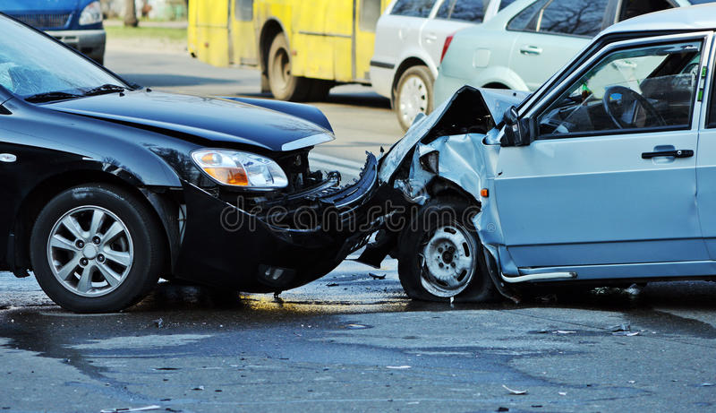
2.Road accidents and railway accidents
Road accidents

Slide 27
Causes
Small size of roads
Heavy traffic/over crowding of vehicles.
Not following traffic rules.
Driving without license.
Driving in drunken states.
Over speeding
Effects
Loss of life, vehicles etc.
Precautions→
Road size should be increased.
More roads flyovers and bypass roads should be constructed.
People should follow traffic rules.

Slide 28
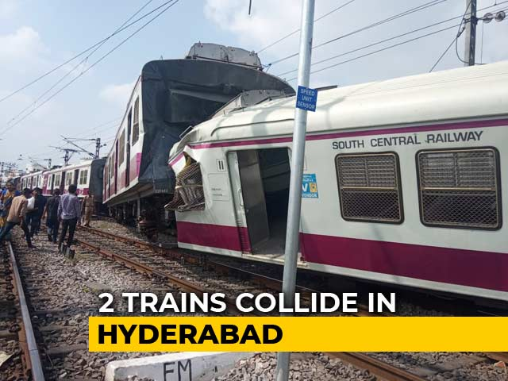
Railway Accidents

Slide 29
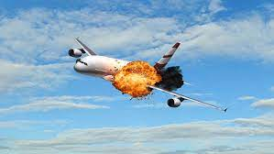
Causes
Human mistake
Damage of railway tracks due to floods, earthquakes etc.
Fire in coaches
3. Air accidents

Slide 30
Proper checking of aeroplanes before flying, Airports should be constructed away from residential areas.
Nuclear accidents, chemical spills, chemical accidents, nuclear wars, Economic collapse, Dam failure, explosion.
Biological disasters→
Epidemic, pandemic, covid 19, influenza, Dengue, HIV/Aids, flu etc.
Covid -19

Slide 31
THANK YOU

